Slide 1
Solar radio observations at Metsähovi Radio
Observatory
Juha Kallunki and Merja Tornikoski + MRO team, Metsähovi Radio Observatory, Aalto University
YERAC 2022

Slide 2
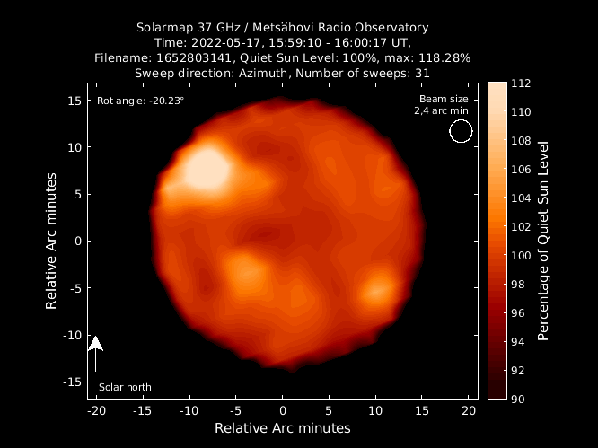
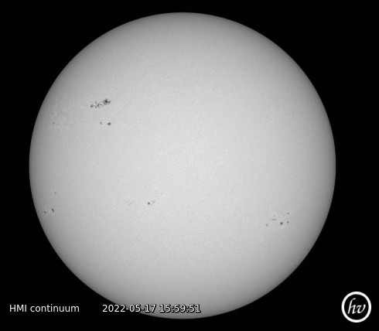
Solar radio map at 37 GHz
1
1
3
3
2
2
Solar radio map at 37 GHz
Solar disk at 6173 Å (photosphere)

Slide 3
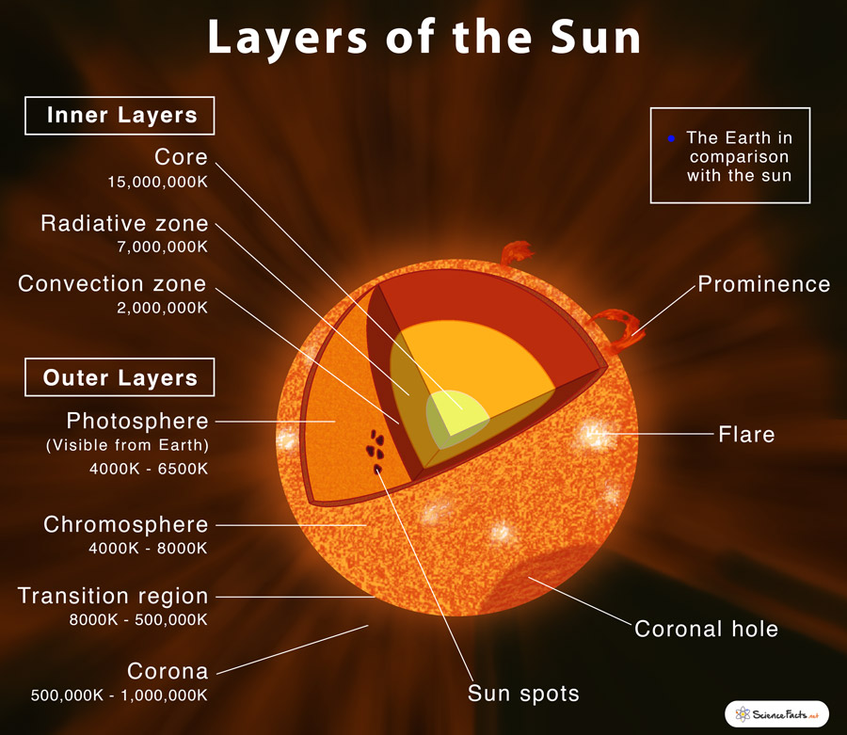

Slide 4
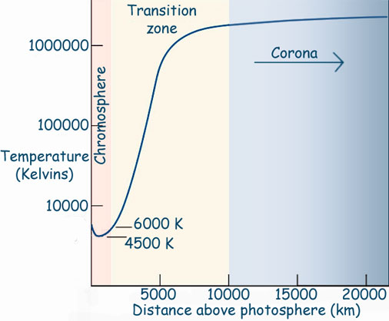
The temperature structure of the solar atmosphere
Coarse classification:
mm-range
cm-range
dm- and m-ranges

Slide 5
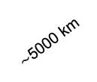
The difference between sunspot and radio brightenings, RB (emission)
Radio brightening
Radio brightening
Sunspot
Fluxes
Chrosmosphere
$\sim$5000 km
The Sun
Photosphere
Spicules, filaments, coronal loops (or processes caused magnetic reconnection) could cause RB’s which are not seen in the photosphere.

Slide 6
The connection is not so straightforward…
Smirnova et al. (2015)

Slide 7
Solar observation and research in MRO
MRO is very well-known about solar radio maps at 37 GHz (14-metre radio telescope)
Regular observation since 1978, and “daily” observation since 2011
  In summer months dedicated solar observation days → 300-400 daily solar maps on period of 12-14 hours
Currently, solar observations also at lower frequencies (20-890 MHz, 10.7-11.7 GHz)

Slide 8
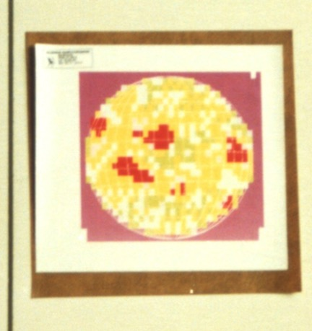
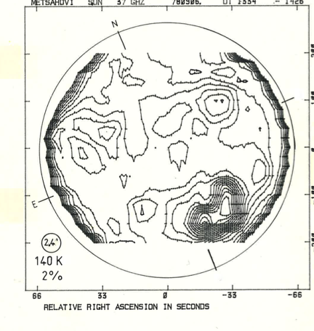
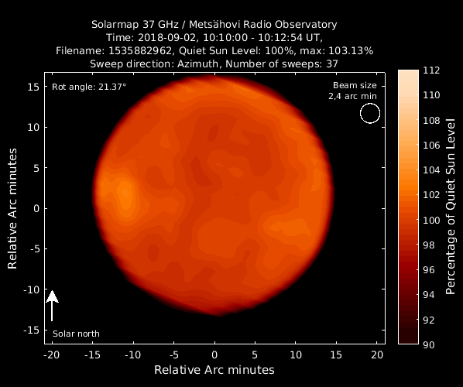
Evolution solar maps
The first observed MRO solar radio map from 1975 or 1976
The MRO solar radio map from 1978
The MRO solar radio map after 2010

Slide 9
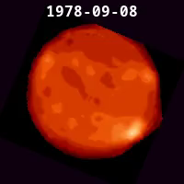
And the same in video format…
One representative map from each day (when observations have been made)
No any filtering → some bad quality maps among
Shows nicely the solar cycles

Slide 10
Solar radio maps 37 GHz – observations
Other more complicated scanning methods also available
One single map observation takes 70 s as a fastest
No straightforward calibration methods – brightness temperature relatively
Some assumptions have to be made
However some special calibration possibilities: (New) Moon
…
…
MRO solar radio map

Slide 11
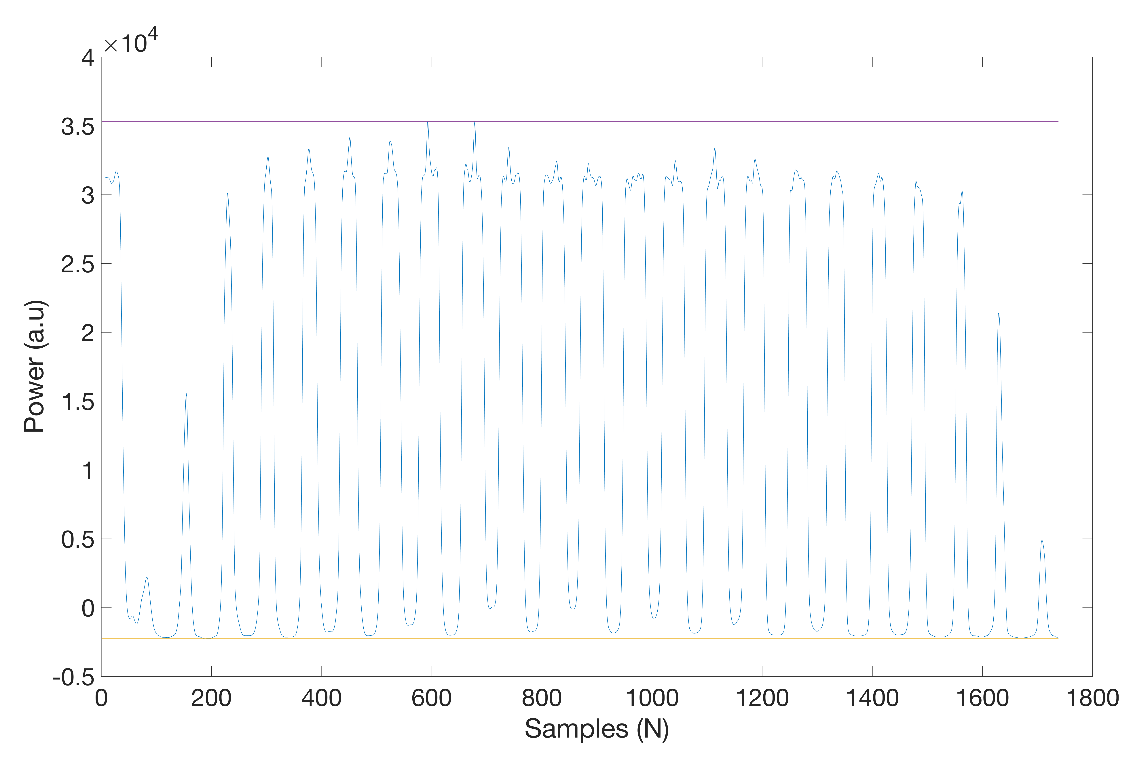
Defining quiet Sun level (QSL)
Max. value of solar map observation → ”some active region”
Quiet Sun Level (100 %) → median(Values__{in})
Values included (Values__{in})
min + (max-min)/2 --> Solar limb
Values excluded (Values__{out})
Min. value of solar map observation → cold sky
Sweeps over solar disk → solar radio map can be contructed

Slide 12
Defining solar brightness temperature at 8 mm
Moon brightness temperature is very well-known and it is rather stabile over the whole moon phase
Series of consecutive solar and lunar map during (+/- 3 days) the New Moon
214 K
38 K @ 8 mm
32º @ 8 mm
12.26º / day

Slide 13
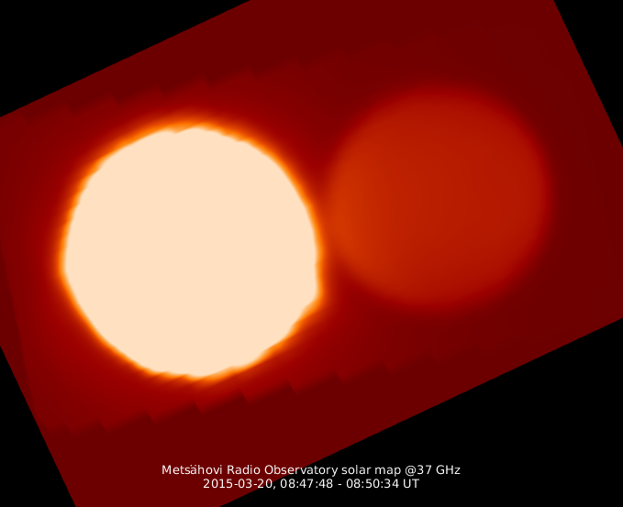


Dynamic range of solar instrumentation (observation)
Sun ($\sim$8000 K)
Moon ($\sim$250 K)
Partial solar eclipse in 2015

Slide 14

Defining solar brightness temperature at 8 mm using lunar observations
8100 $±$300 K
Kallunki and Tornikoski, 2018.

Slide 15
A brief historical revision – research themes
1980-1990
  Event basis analysis
  Oscillations and pulsations, e.g. 160-min oscillations
1990-2000
  Polar features (brightenings) at radio wavelengths
  Differential rotation (high and low temperature regions)
  Multi-frequency (radio vs. x-ray etc.) flare analysis
2000 →
  Cyclicity studies
  Multi-(radio)frequency analysis
  Technical upgrades - adding new observation bands (< 1 GHz – dynamic spectra, 11.2 GHz – total intensity)
  Calibration
  Event basis analysis
  Polarization properties
  Quiet Sun features

Slide 16
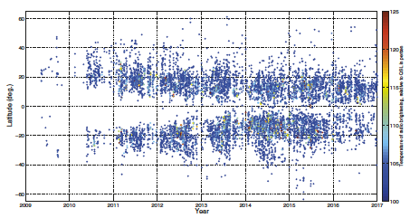
Solar cyclicity study on the basis of the radio brightenings
Radio butterfly diagram
  - Solar Cycle 24
Kallunki et al. 2018

Slide 17
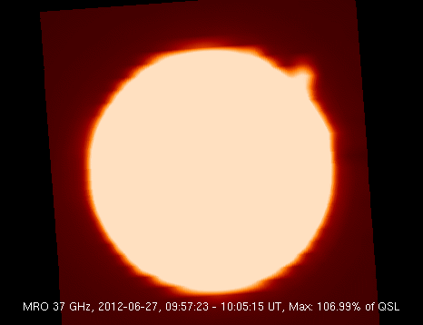
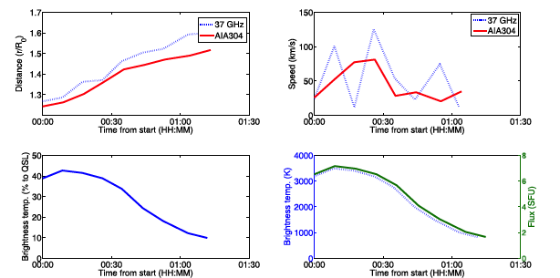
Eruptive solar prominence at 37 GHz
27th June 2012 – radio prominence
37 GHz vs. AIA 304 Å (both from transition region/chromosphere)
Kallunki and Tornikoski, 2017

Slide 18
Polarization properties of RB
Not a standard observing system
VLBI receiver is in use
Observations can be made on time of VLBI sessions
Major research topic in the future (new receiver)
Kallunki et al. 2020

Slide 19
Quiet Sun features
Rising flux tubes (from e,g, coronal holes), which are getting hotter in the high atmospheric layers are seen as RB
Polar faculae, small magnetic bright points,… and sum of these
Weak RB
Coronal hole
Kallunki, Tornikoski and Björklund 2020

Slide 20
Summary about 8 mm solar observations
Unique collection of high frequency solar radio maps
Long, continuous observations sessions on summer months
Flexible scheduling, if major activity on the Sun, the telescope can be scheduled for solar observations
RFI (Radio Frequency Interference) environment is still favourable for astronomical observations at higher frequencies
Absolute calibration is a challenge!

Slide 21
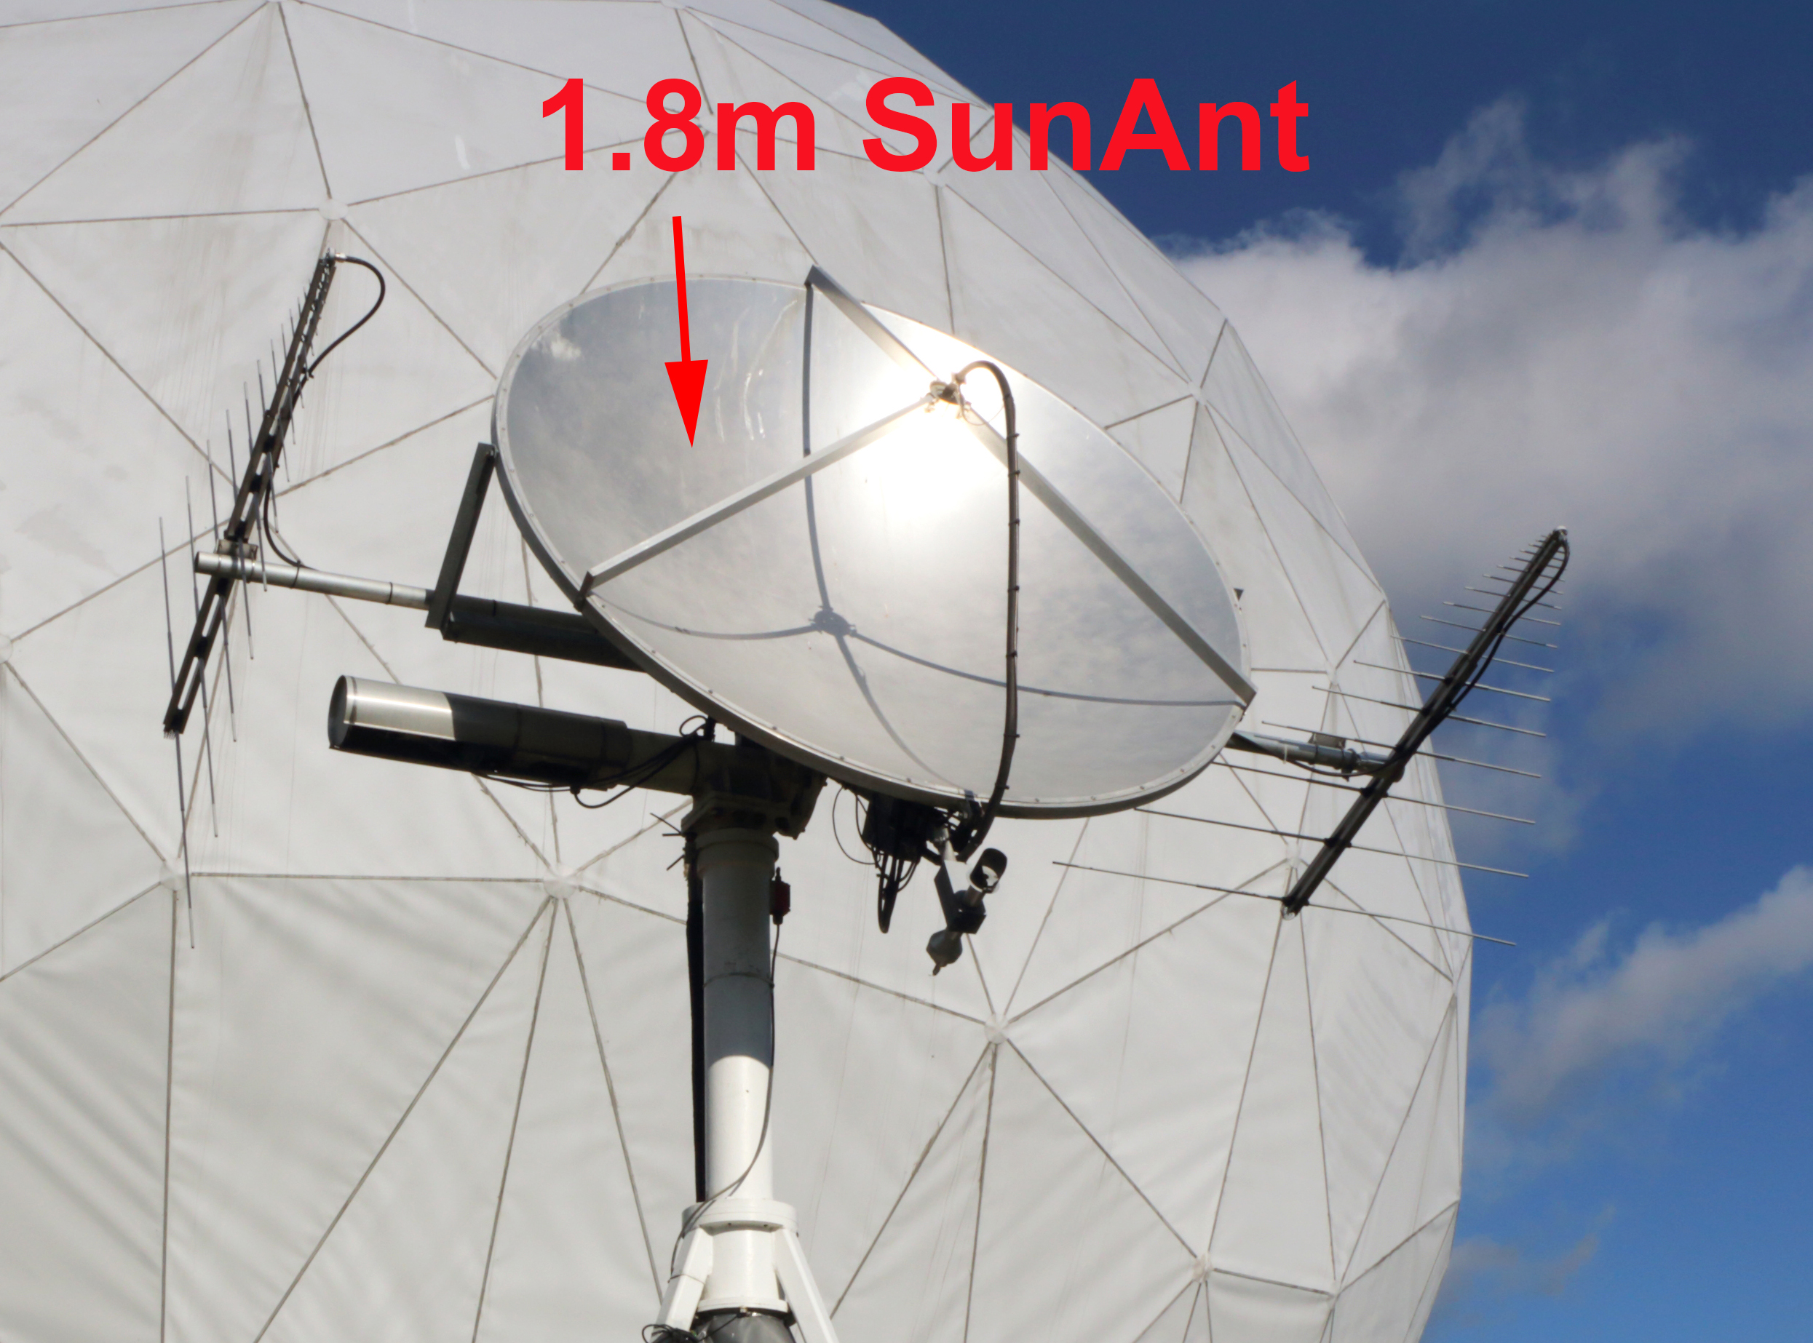
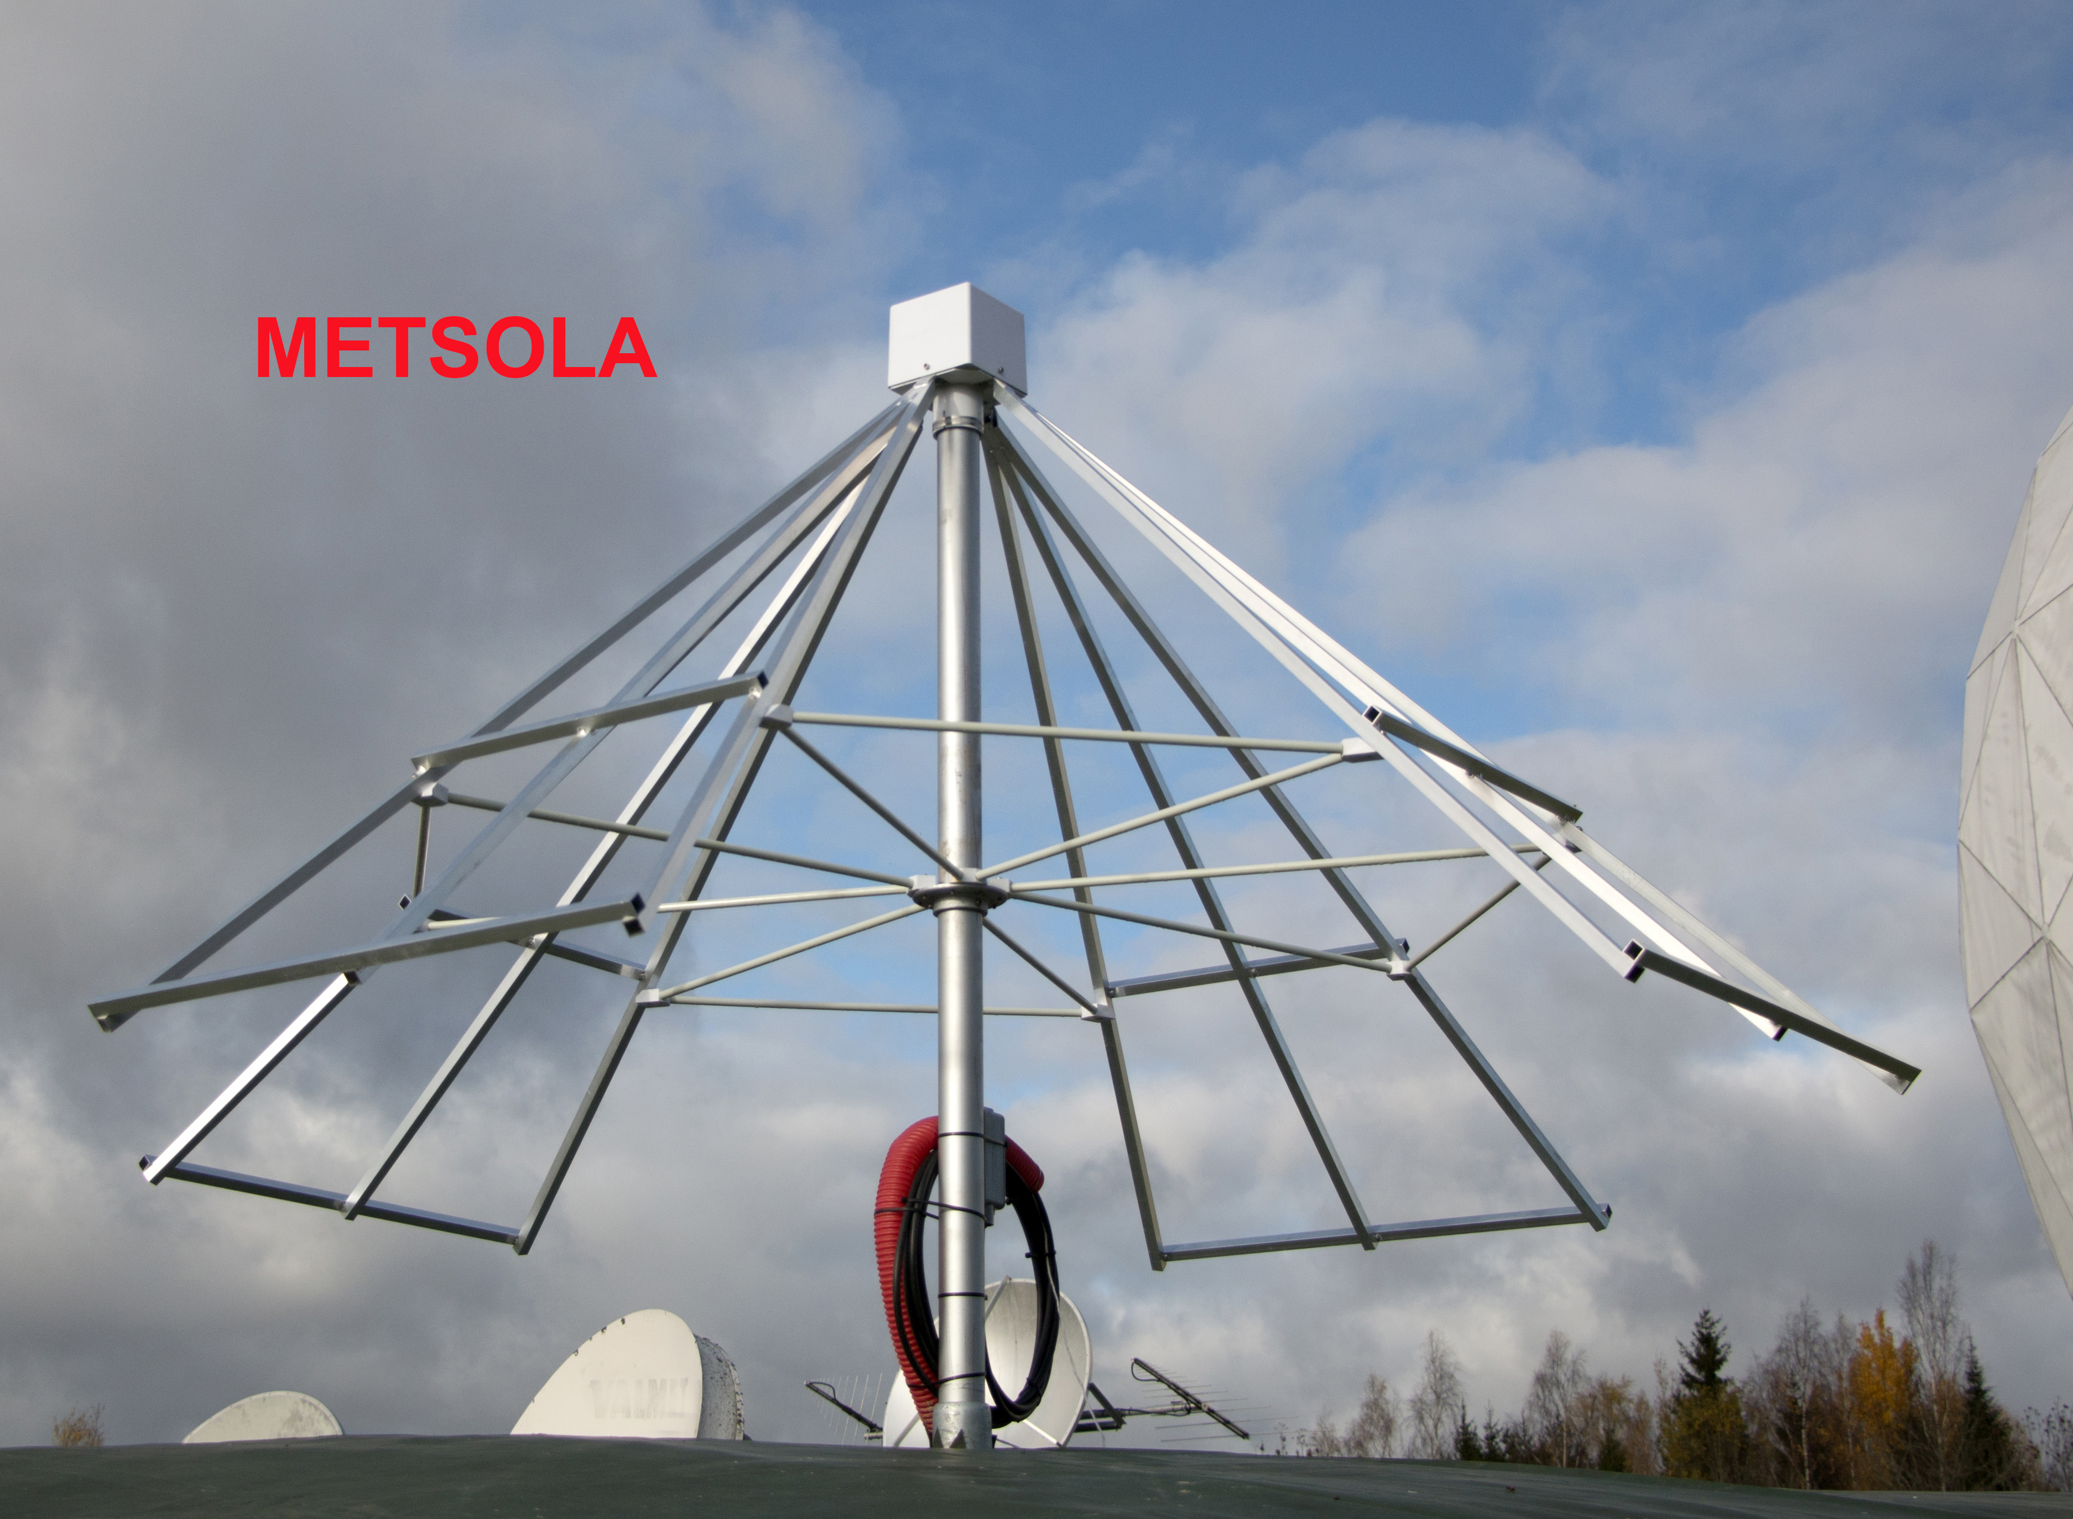
Other solar instrumentation in MRO
Callisto
1.8m Sunant @ 10.7–11.7 GHz
Callisto @ 45–870 MHz
METSOLA @ 15–85 MHz

Slide 22
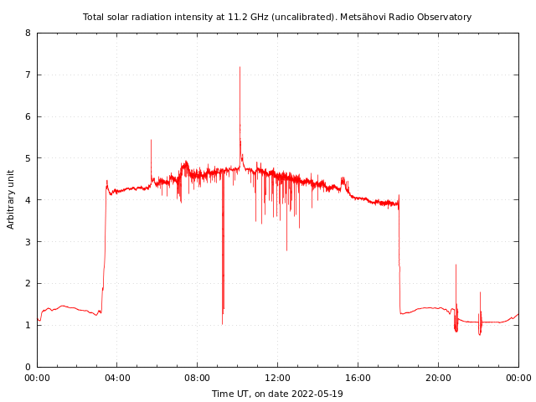
Sunant – 11 GHz solar total flux
6990 + 0700 0719 0731 G16 5 XRA 1-8A M5.6 5.4E-02 3017
7040 + 1000 1009 1020 G16 5 XRA 1-8A M1.5 1.1E-02 3014
Total flux → the beam size is larger than the Sun
Operational since 2001
“Built using commercial components”
10.7-11.7 GHz range is also operating range of GSO satellites, and (new) satellite mega-constellations (e.g. StarLink and OneWeb) → major problem in the future

Slide 23
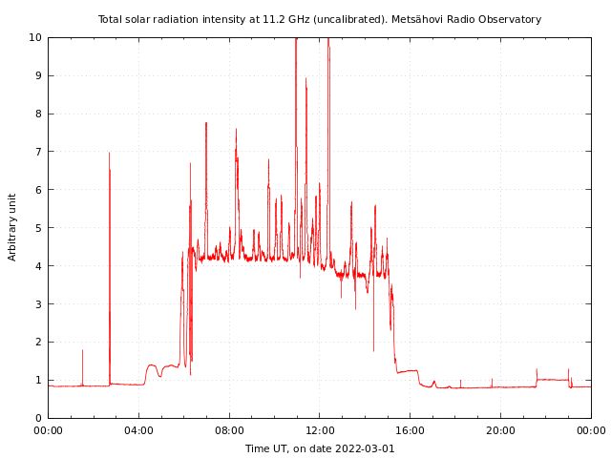
11 GHz solar total flux as solar cyclicity indicator
GSO interference, two period over a year (each 10 days)
Kallunki and Uunila 2015

Slide 24
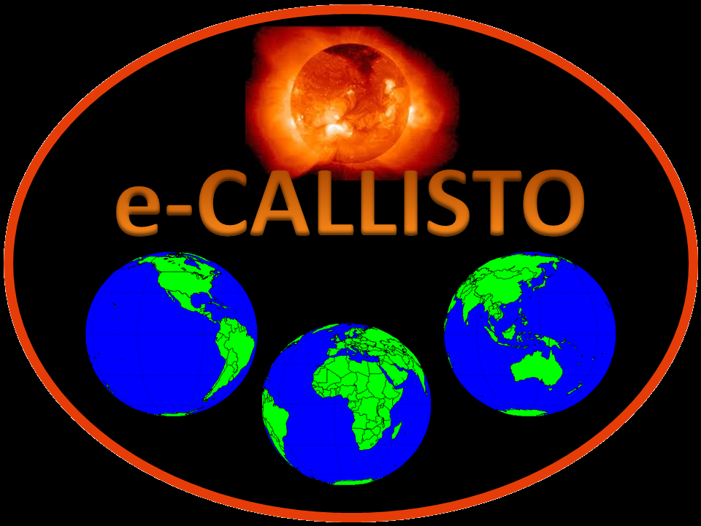
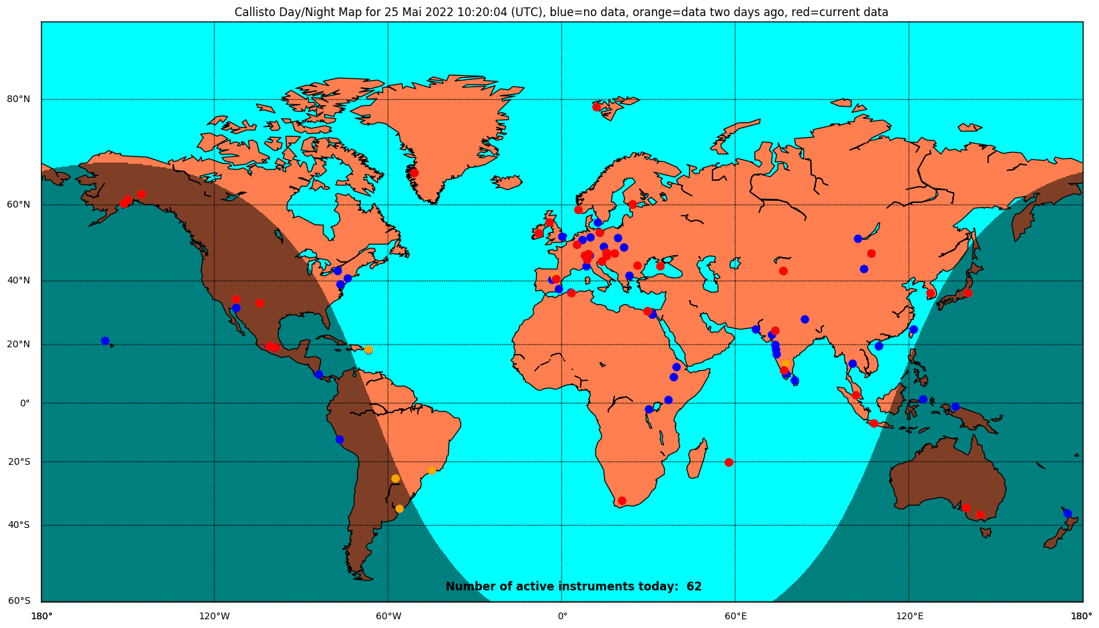
e-Callisto network
A network of solar monitoring facilities (< 1 GHz)
Professional observatories, private persons,…
All have a similar back-end (CALLISTO spectrometer by C. Monstein, ETH Zurich)
Other technical instruments (antenna, LNA, e.g.) are station specific
Totally > 50 stations
MRO has 4 CALLISTO spectrometers in operation

Slide 25
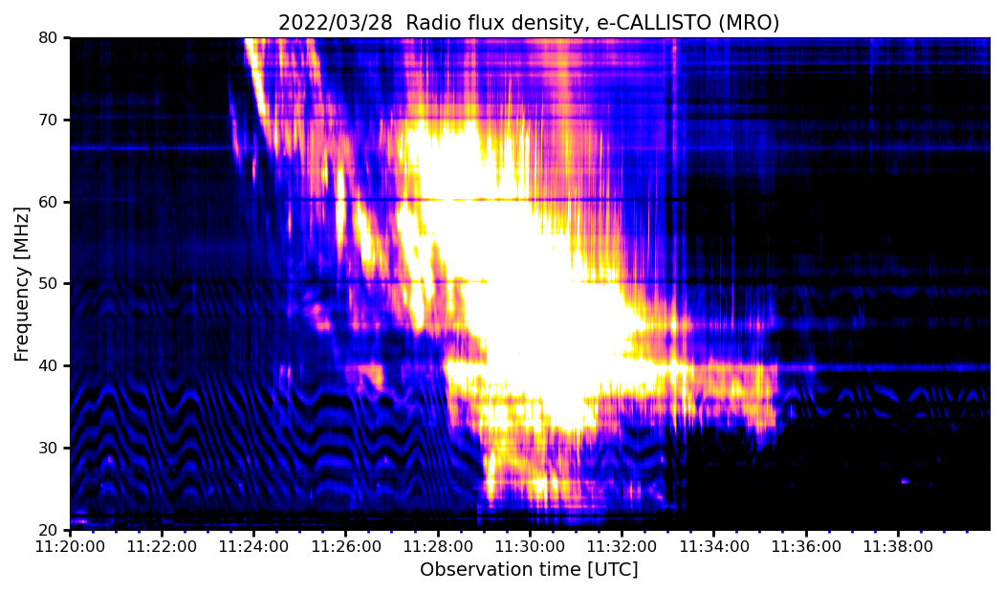
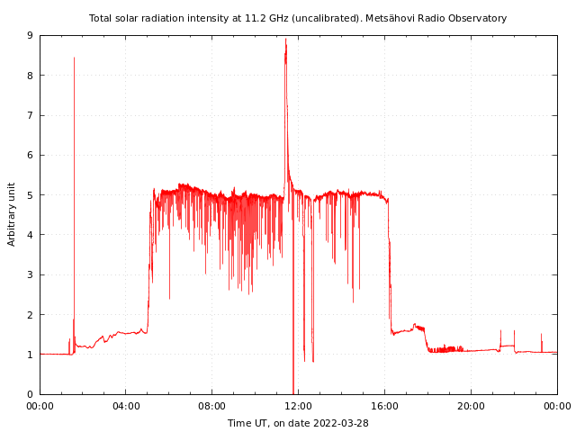
Some low-frequency solar radio bursts
Type II burst
Lasting over 10 minutes → extremely long lasting, “unique”
M-class (M4.0) flare

Slide 26
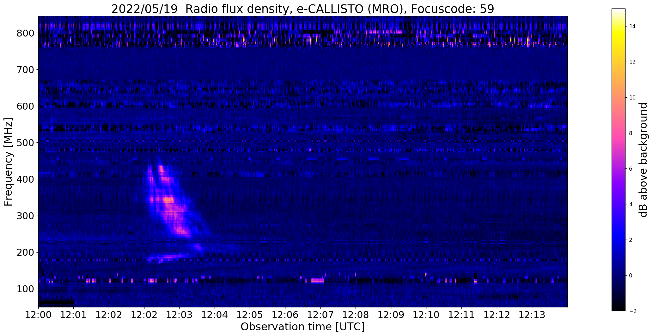
Some other low-frequency solar radio bursts
No event at 11.2 GHz
Low-frequency solar radio bursts are the most common ones!

Slide 27
Example of radio burst study
Observation comparison between MRO and KAIRA (Kilpisjärvi Atmospheric Imaging Receiver Array), http://kaira.sgo.fi
  Drift rates, propagation speeds, start and stop distances,…
  Very similar results, even if conditions and technical approach are very different
Kallunki, McKay and Tornikoski 2021

Slide 28
Summary about low frequency solar observations
The Sun is active at low frequencies (also on time of solar minimum) → a lot of events to analyze
Simple technical infrastructure is required → new technical extensions can be added much easily
RFI is a big problem now, and increasingly in the future
Atmospheric (=weather) conditions are not so critical factor during observations

Slide 29
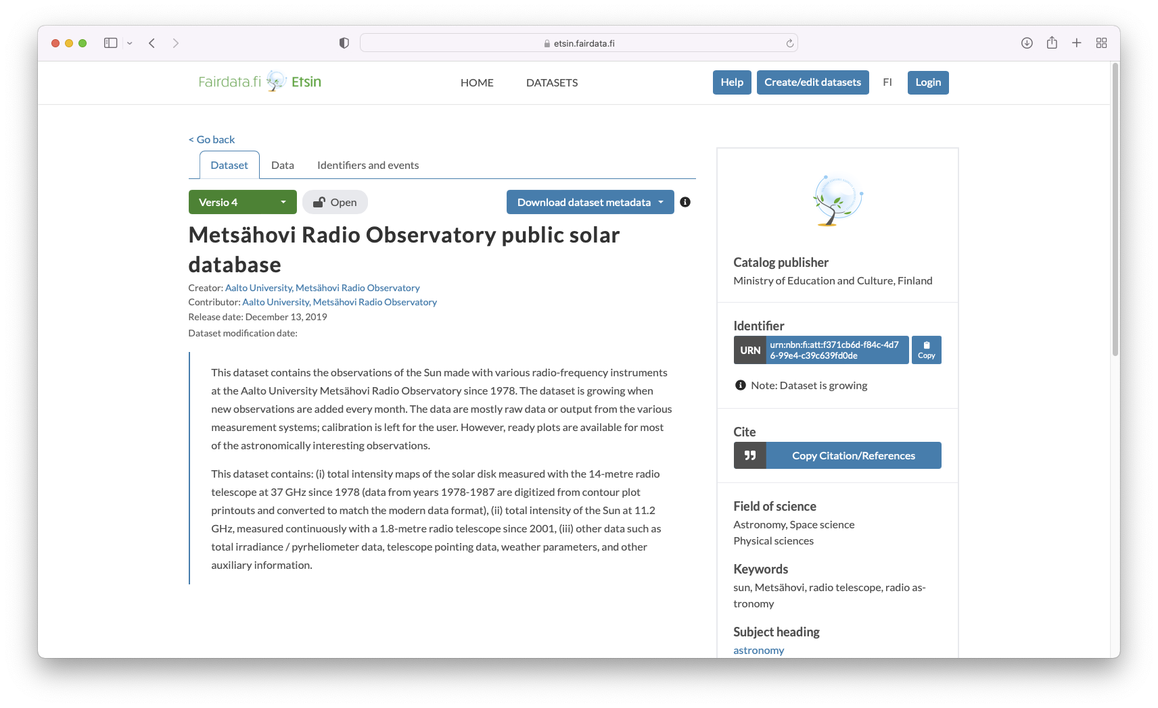
Open solar radio data
All data are available from: https://etsin.fairdata.fi → search word ”metsahovi solar”
Note: one month delay on publishing the data
Daily solar observations in Metsähovi: http://www.metsahovi.fi/sun/data/

Slide 30
Future operations and works
Continue with the daily solar observations
  In the future, simultaneous triple-band observations with MRO-14, also with polarization option
Cyclicity studies, event basis analysis, comparison radio data to other wavelengths,…
Improving (further) data (observation) calibration
How to operate with increasing RFI? New technical solutions?

Slide 31
Thank you!

